Slide 1

Project Presentation On
♟ Chess : Mastering the Game ♟
Course Code : CSE-3636
Submitted To :
Sara Karim
Adjunct Lecturer, Dept. of CSE, IIUC
Submitted By :
Nahian Subah Ishma_C223286
Rehnuma Tasneem_C223288
Saima Kawsar_C223297
Semester : 6th

Slide 2
Introduction :
Overview:
- A chess-playing game that implements all chess rules, including advanced moves.
- Demonstrates game decision-making in a strategic game environment.
Importance:
- Develops expertise in game programming and logic.
- Enhances understanding of decision-making algorithms.

Slide 3
Game Design and Concept
Why I Chose This Project ?
-Hands-on AI Application: Implementing AI algorithms in Python.
-Challenging Complexity: Chess offers a complex, strategic environment to develop advanced AI.
-Skill Growth: Enhances my programming and AI skills.
-Real-World Relevance: A functional chess game that demonstrates practical moves to use in gaming.

Slide 4
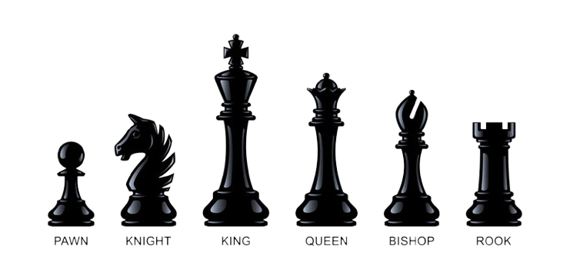
Main Character
Pawn: Moves one square forward (two squares on its first move), captures diagonally
Knight: Moves in an "L" shape (two squares in one direction, then one perpendicular)
King: Moves one square in any direction
Queen: Moves horizontally, vertically, or diagonally any number of squares
Bishop: Moves diagonally any number of squares
Rook: Moves horizontally or vertically any number of squares

Slide 5
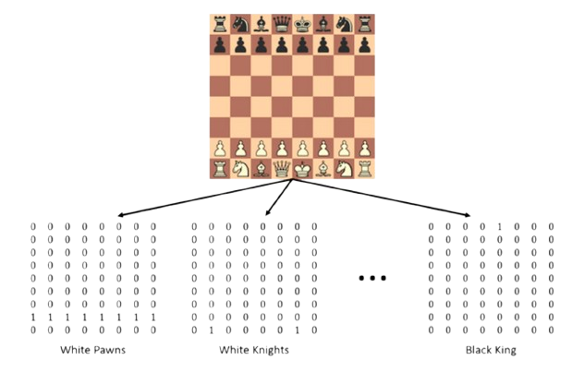
Board Representation

Slide 6
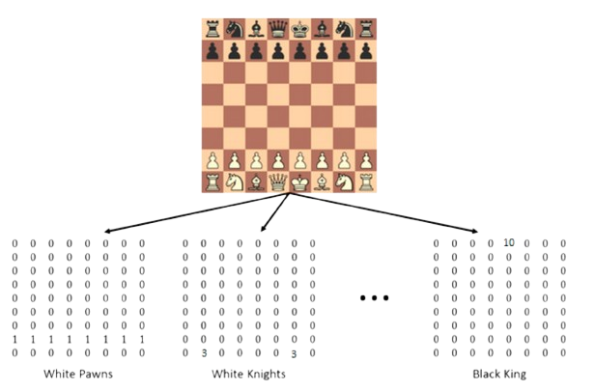
Board Representation

Slide 7
Game Play
- Goal: The goal is to checkmate your opponent’s king, meaning the king is under threat and cannot escape capture.
- Turns: Players take turns moving one piece at a time, starting with the white player.
- Winning: A player wins by checkmating the opponent’s king or if the opponent resigns.
- Draw: The game ends in a draw if there is a stalemate (no legal moves left), threefold repetition, or insufficient material to checkmate.

Slide 8
Features
Full Chess Rules
Includes advanced moves: castling, en passant, and promotion
2-Player Mode
Play against another person with the help of AI moves
Interactive Chessboard
Real-time board updates with valid move highlighting with a status bar under
the board . As pieces are captured, they are immediately added to the sidebar
Visual Representation
Captured pieces are displayed on the side of the board, organized by player

Slide 9
Features (Continued)
The following algorithms and techniques were implemented:
1. Game Over Detection
Checks if a King is captured to declare the winner
Does not yet evaluate checkmate or stalemate conditions
2. Turn-Based Control
Alternates between White and Black players using a turn variable
Players select and move pieces during their turn
3. Piece Capture and Board Updates
Captures opponent pieces when a valid move lands on an occupied square
Updates the board state after each move

Slide 10
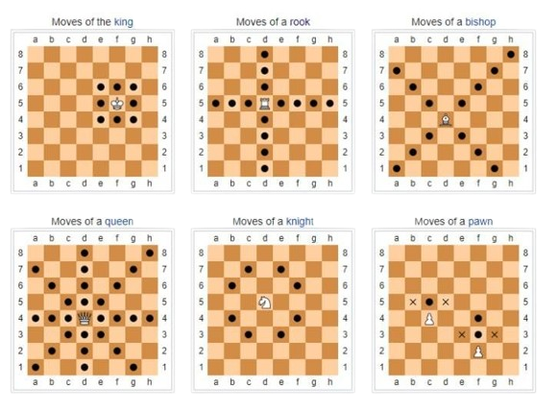
Features (Continued)
4. Brute Force Move Generation
Generates valid moves for each chess piece by exploring all possible directions.
a. Rook: Moves along horizontal and vertical lines until blocked.
b. Bishop: Moves diagonally until blocked.
c. Knight: Jumps in an "L-shape" to specific squares.
d. Pawn: Moves forward; captures diagonally.
e. King: Moves one square in any direction.
f. Queen: Combines Rook and Bishop moves

Slide 11
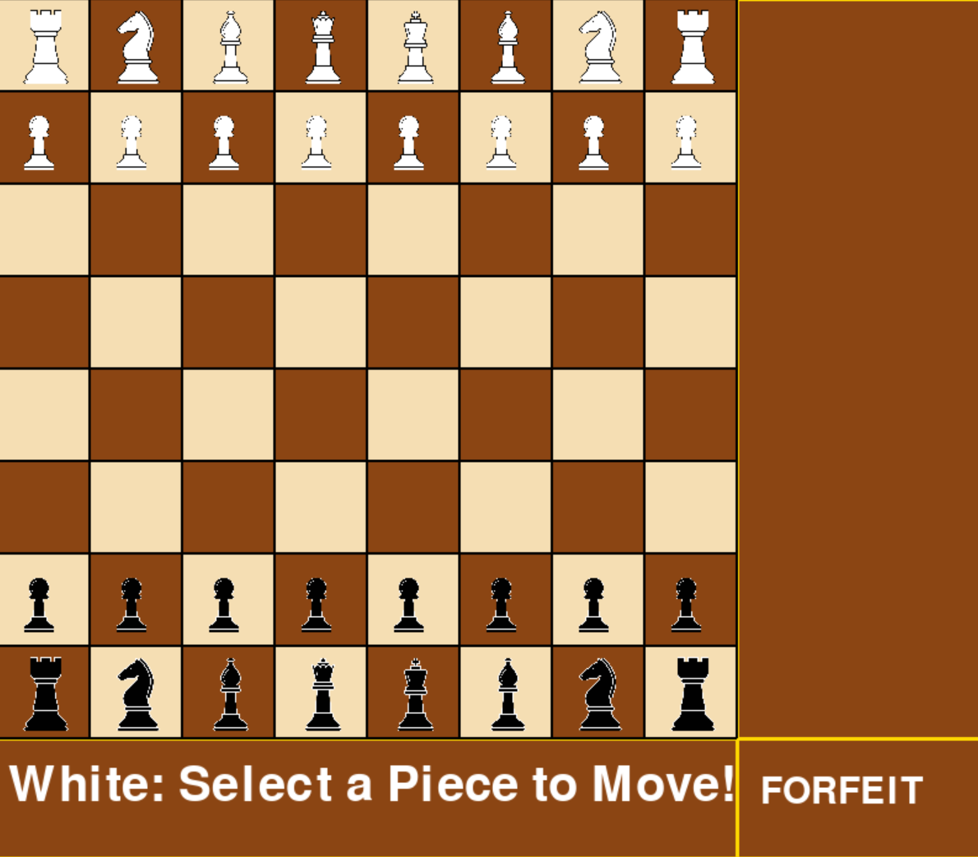
User Interface

Slide 12
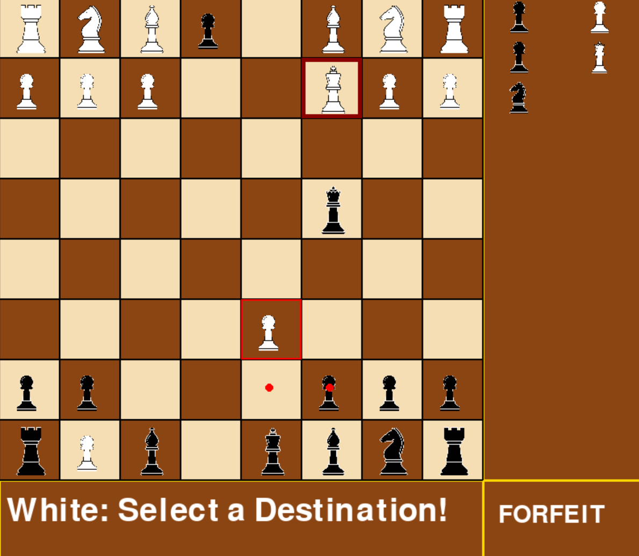
User Interface (Continued)

Slide 13
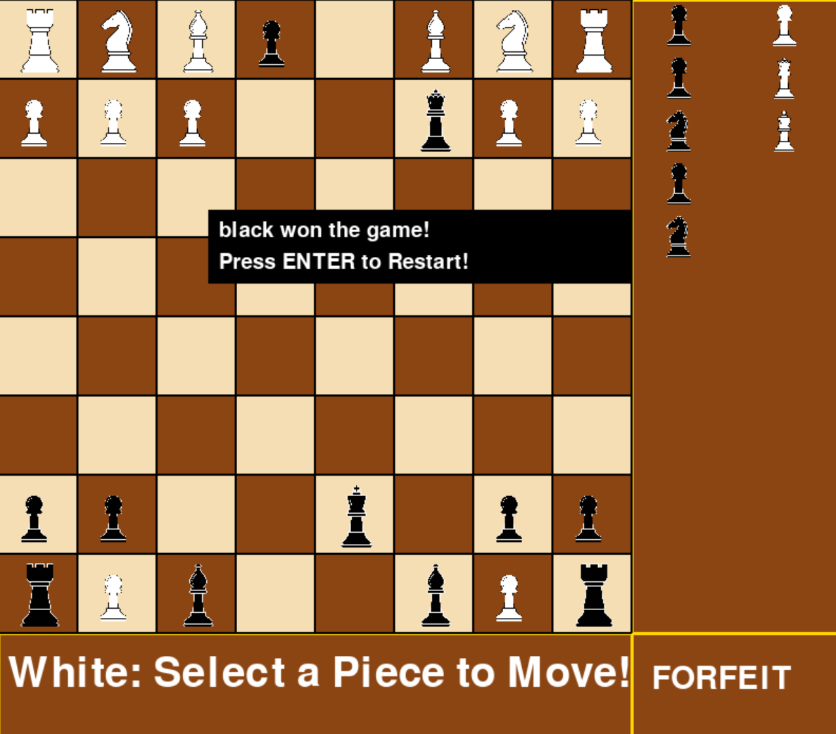
User Interface (Continued)

Slide 14
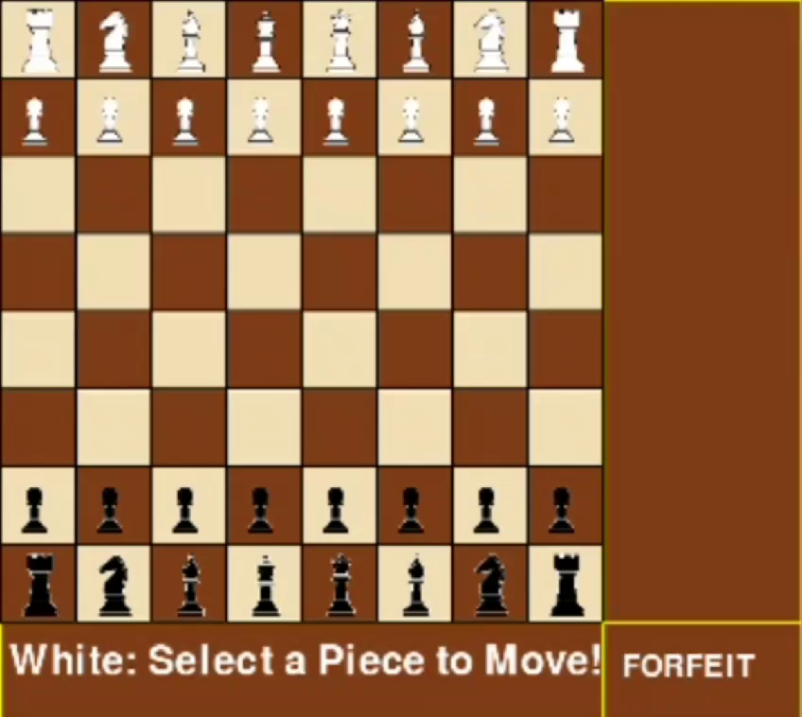
A Glimpse of the Game

Slide 15
Challenges
Implementing complex rules like en passant and castling.
Designing an effective heuristic evaluation function.
Optimizing AI performance for faster move calculations.
Future Work
Adding difficulty levels for AI.
Improving heuristics using machine learning techniques.
Enabling multiplayer or online gameplay features.

Slide 16
Conclusion
Developed a chess-playing AI with full rule support
Explored and implemented key algorithms for strategic decision-making
Gained experience in game development and AI programming

Slide 17
Thanks for Playing!
See you next time!

Slide 18
Q&A Session !

